Slide 1

CYBER SECURITY

Slide 2
DOS ATTACK USING NS2

Slide 3



DOS ATTACK USING NS2
Creating a network Topology and generate TCP and UDP Traffic.
Perform Denial of Service attack on Network.

Slide 4
AGENDA
A DoS or Denial-of-Service attack is an attack targeting the availability of web applications. Unlike other kinds of attacks, the primary goal of a DoS attack is not to steal information but to slow or take down a web site. The attackers' motivations are diverse, ranging from simple fun, to financial gain and ideology ( hacktivism ). A denial of service attack generates high or slow rate attack traffic exhausting computing resources of a target, therefore preventing legitimate users from accessing the website.
The main agenda of this project is to show the DoS attack within a network using NAM and NS2.

Slide 5

PROJECT OVERVIEW
As we know most of the companies are facing problems because of this denial of service attack which can cause four types of attacks.They are
Penetration
Eavesdropping
Man in the Middle
Flooding
In order to overcome such type of issues and our project provides a solution.By introducing strategic firewalls ,switches and routers we can reduce the effect of DoS attacks.

Slide 6

WHO ARE THE END USERS?
The End users are web servers of high-profile organizations such as banking, commerce, and media companies,
or government and trade organizations. Though DoS attacks do not typically result in the theft or loss of significant information or other assets, they can cost the victim a great deal of time
and money to handle.

Slide 7
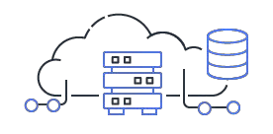
SOLUTION AND PRESENTATION
Request Verification and CAPTCHA: Implement request verification mechanisms to ensure that only legitimate users can access your services. CAPTCHAs can help prevent automated attacks.
Incident Response Team: Establish an
incident response team to handle DoS attacks promptly and effectively.
Firewalls and Intrusion Prevention Systems (IPS): Configure firewalls and IPS devices to
filter and block suspicious traffic. Regularly update the rules and signatures to protect against known attack patterns.

Slide 8

WOW IN SYSTEM
Network Security
Traffic Control
Real-time Protection
Security policy Enforcement
Bot Mitigation
User Experience improvement
Rapid Response
Threat Analysis
Learning and improvement
Compliance and Reporting

Slide 9
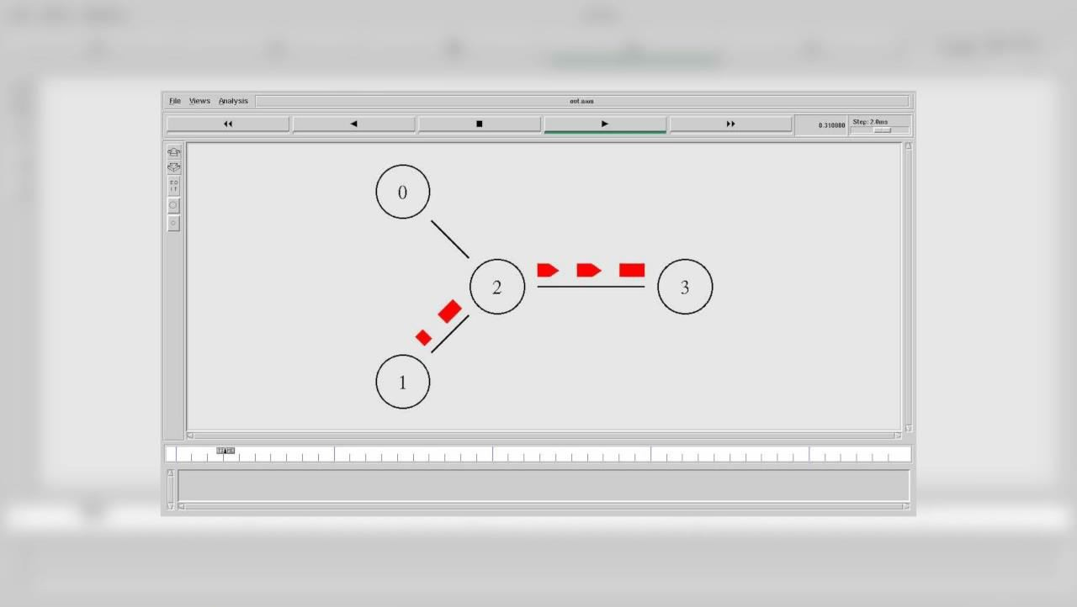
MODELLING

Slide 10









RESULTS
Denial of service is currently the most expensive computer crime for victim organizations.
Strategic firewall placement allows companies to use the Internet during a DoS attack, and it allows them to continue receiving the packets they want.
It is easy to generate a successful DoS attack that bypasses these defenses.
Github link: https://github.com/sindhujaaguru/DOS-ATTACK/upload

Slide 11

LINKS
Github link: https://github.com/sindhujaaguru/DOS-ATTACK/upload
Reference link: https://skillsbuild.edunetworld.com/courses/cs/dos-attack-using-ns2/

Slide 12
THANK YOU..

